Slide 1
Spring Boot Microservices
Section 2

Slide 2
Challenges of Microservices
How to handle below things with Microservices
Deployment
  How do we deploy all tiny 100s of Microservices with less efforts and cost?
Portability
  How do we move our 100s of Microservices across the multiple environments with less efforts, configurations and cost?
Scalability
  How do we scale out applications based on the demand on the fly with minimum effort and cost?

Slide 3
Solution
Containerization

Slide 4
Containerization
Containers offers a self contained and isolated environment for applications.
Including all necessary dependencies.
By containerizing an application, it becomes portable and can run seamlessly in any cloud environment.
Containers enables unified management of applications regardless of language or framework used.

Slide 5
How do we containerize the Maven application?
Docker
  It is an open-source platform to package and run an application in loosely isolated environment.

Slide 6
How Containers are different from Virtual Machines?
Virtual Machine 1
Virtual Machine 2
Virtual Machine 3
Application 1
Application 2
Application 3
bin/library
bin/library
bin/library
Gust OS
Gust OS
Gust OS
Hypervisor
Server – Physical Hardware

Slide 7
Problems of Using Virtual Machine
What if you have 100s of Microservices?
  Its difficult to create 100 VMs
What if you install multiple applications on single VM?
  How you will handle the requirements of each application, such as each application needs different software, RAM and configurations?
If we need to take restart of Virtual Machine?
  All application will be affected/down which is not acceptable.
How you will achieve scalability?
  If you want to create multiple Virtual Machines then it’s a time consuming process.
  Deleting Virtual Machine after scalability is also is time consuming.

Slide 8
Containers
Container 1
Container 2
Container 3
Application 1
Application 2
Application 3
bin/library
bin/library
bin/library
Container Engin
Host Operating System
Server – Physical Hardware

Slide 9
Advantages of Using Containers
Containers don’t need separate operating system; they share the Host Machine Operating System.
As Guest operating system is not there for container they become light weight and creating, destroying, restarting will take only few seconds.
Inside the same server containers can have separate isolated environment.
  Container 1 : Java 8
  Container 2 : Java 17
  Container 3 : Python
Installation of new application within container is very fast and simple using command.

Slide 10
What is Container?
A Container is an isolated environment that allows us to build & run software packages.
These software packages include the code and all dependencies to run application quickly & reliably on any computing environment.
We call these packages as Container.
From our Microservices application we will create the container images.
From the container image we can create any number of containers.
Example From a Class we create any number of objects.

Slide 11
What is Software Containerization?
Software containerization is an operating system virtualization method, that is used to deploy and run containers without using any virtual machine.
Containers can run on physical hardware, in cloud and across multiple operating systems.

Slide 12
How Container is different from Virtual Machine?
Already explained.
In case of Virtual Machine – The virtualization is at hardware level.
In case of Container – The virtualization is at operating system level.

Slide 13
What is Docker?
Docker is an open-sourced platform or product.
Docker enables developers to automate the deployment, scaling and management of application using containerization.

Slide 14
What exactly happen inside containerization?
In containerization Linux features such as namespace and cgroups play a very crucial role in providing isolation and resource management.

Slide 15
What is namespace ?
Namespace is a concept of Linux which allow creation of isolated environments within the same operating system.
Each container has its own set of namespace, including process, network, mount, IPC(Inter Process Communication) and use namespace.
These namespaces ensure that processes within a container are only aware of their specific namespace, providing a level of isolation.

Slide 16
What is Control Group(CG)?
Control Group provides resource management and allocation capabilities for containers.
Control Group control and limit the resources such as CPU, memory, disk, IO & network bandwidth the container can consume.
By Control Groups container runtimes can enforce resource restrictions and prevent one container from monopolizing system resources, ensuring fail allocation among containers.

Slide 17
How dose Docker works on MAC & Windows?
If you install Docker Desktop on MAC or Windows system, Only Docker client is installed on your system.
Behind the scenes, a light weight virtual machine is configured with Linux and the Docker server is install within that virtual machine.

Slide 18
Docker Architecture?
Docker Client
Docker Server - Host
Docker Registry
Using Docker Demon, we create and mange Docker Images
1
2
Docker Remote API
Docker Demon
Docker Hub
Containers
Images
We can issue commands to Docker
Demon using Docker API or Docker CLI
Container 1 of App
Docker Images can be pulled from Docker Hub or private registry
Image of App
3
Container 2 of App
5
4
MySQL Image
Docker CLI
MySQL Container
Private Registry

Slide 19
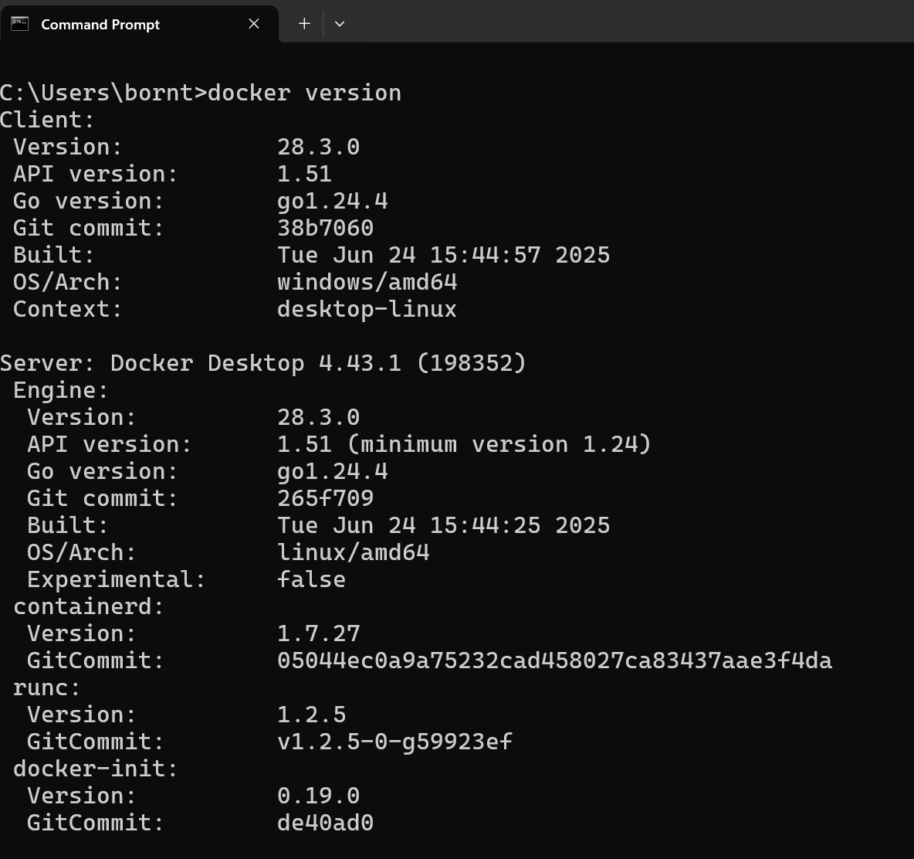
Docker Installation Steps
https://www.docker.com
Download and install docker.exe
Verify using below command in cmd
  docker version

Slide 20
Generate Docker Images
To generate docker images from our existing microservices, we will explore the below three different commonly used approaches
Using Docker file – Accounts Microservices
  We need to write a docker file with the list of instructions which can be passed to Docker server to generate a Docker image.
Using Buildpacks – Loans Microservices
  Buildpacks is a project initiated by Heroku & Pivotal. It simplifies containerization since we don’t need to write a docker file.
Google Jib – Cards Microservices
  Jib is an open-source Java tool maintained by Google for building Docker images of Java application. It simplifies containerization since we don’t need to write a docker file.

Slide 21
Steps to generate Docker image of Account microservices
Add packaging tag into pom.xml
  <packaging>jar</packaging>
Validate Maven installation and version using below command
  mvn –version
Clear and Build the jar file for account microservice
  mvn clean install
Start account application using Maven command
mvn spring-boot:run
Start account application using Java command
    java –jar target/accounts-0.0.1-SHAPSHOT.jar

Slide 22
Steps to generate Docker image of Account microservices
Make sure your docker service is running in local system
Create new file as dockerfile in accounts folder as below
#Start with a base image containing Java runtime
FROM openjdk:21-jdk-slim
#Information about who maintains the image
LABEL "org.opencontainers.image.authors"="eazybytes.com"
# Add the application's jar to the image
COPY target/accounts-0.0.1-SNAPSHOT.jar accounts-0.0.1-SNAPSHOT.jar
# execute the application
ENTRYPOINT ["java", "-jar", "accounts-0.0.1-SNAPSHOT.jar"]

Slide 23
Steps to generate Docker image of Account microservices
Verify the Docker is running on local system
  docker version
Run Docker build command to build image
  docker build . –t borntocode/accounts:s2
Print list of all images from Docker Desktop
  docker images

Slide 24
How to create a Docker Container from Docker Image
Command to create docker container from docker image
  docker run -d –p 8080:8080 borntocode/accounts:s2
Validate by sending request from postman
  http://localhost:8080/api/create
List of existing running containers
  docker ps
List of all stopped containers
    Docker ps –a
Same can be validated from the Docker desktop

Slide 25
How to start-stop containers with command
Command to start docker container
  docker start <container-id>
Command to stop docker container
  docker stop <container-id>
Creating multiple containers
  docker run –d –p 8080:8080 borntocode/accounts:s2
  docker run –d –p 8081:8080 borntocode/accounts:s2
Test same using postman

Slide 26
Challenges of using Dockerfile
In order to write docker file you have to be expert of Docker concept.
While creating Docker image – We need to make sure that Docker image should be as small as possible.
We need to use caching, compression while generating Docker image.
We should not ignore any security related concept.

Slide 27
Steps to generate Docker image of Loans microservices – Packito Buildpack
Add packaging into pom.xml
Add packito build configuration in pom.xml
Run command
<packaging>jar<packaging>
<plugin>
<groupId>org.springframework.boot</groupId>
<artifactId>spring-boot-maven-plugin</artifactId>
<configuration>
<image>
<name>borntocode/${project.artifactId}:s2</name>
</image>
</configuration>
</plugin>
mvn spring-boot:build-image

Slide 28
Steps to generate Docker image of Loans microservices
Create Docker container
Check in Postman
docker run –d –p 8080:8080 borntocode/accounts:s2
docker run –d –p 8090:8090 borntocode/loans:s2

Slide 29
Steps to generate Docker image of Cards microservices – Google Jib
Add packaging into pom.xml
Add Google jib build configuration in pom.xml
Run command
<packaging>jar<packaging>
<plugin>
<groupId>com.google.cloud.tools</groupId>
<artifactId>jib-maven-plugin</artifactId>
<version>3.4.2</version>
<configuration>
<to>
<image>borntocode/${project.artifactId}:s2</image>
</to>
</configuration>
</plugin>
mvn compile jib:dockerBuild

Slide 30
Steps to generate Docker contrainer microservices
Create Docker container
Check in Postman
docker run –d –p 8080:8080 borntocode/accounts:s2
docker run –d –p 8090:8090 borntocode/loans:s2
docker run –d –p 9000:9000 borntocode/cards:s2

Slide 31
Push Docker images to Docker hub
Use below command
Do the same for cards and loan microservices
docker image push docker.io/borntocode/accounts:s2

Slide 32
Pull Docker images from Docker hub
Use below command
docker pull borntocode/accounts:s2

Slide 33
Docker Compose
Docker compose is an inbuild tool for defining and running multi-container Docker applications.
With Docker compose you use a yaml file to configure your applications services
With single command you can start, stop all the services of configurations.

Slide 34
Docker Compose Configurations
services:
accounts:
image: "borntocode/accounts:s2"
container_name: accounts-ms
ports:
-"8080:8080"
deploy:
resources:
limits:
memory: 700m
networks:
- eazybytes
#Same for cards and loans
networks:
eazybytes:
driver: "bridge"
Create new file at project level
docker-compose.yml
Use below command to start all services
Use below command to delete all containers
docker -d compose up
docker compose down

Slide 35
Docker Compose Commands
docker compose up
  Will create the containers from scratch
docker compose down
  Will stop and delete the containers
docker compose stop
  Will stop the containers
docker compose start
  Will start the containers

